Slide 1

Integrating Type Operators into the FreeST Programming Language
INForum, Lisbon, 5th September 2024
Paula Lopes
Advisors: Diana Costa, Vasco T. Vasconcelos

Slide 2


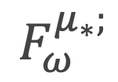
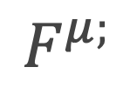
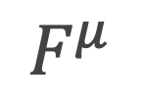
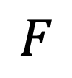
Introduction
FreeST (3.0)
FreeST (3.5)
$$F$$
$$F^{μ}$$
$$F^{μ;}$$
$$F_{ω}^{μ_{∗};}$$

Slide 3

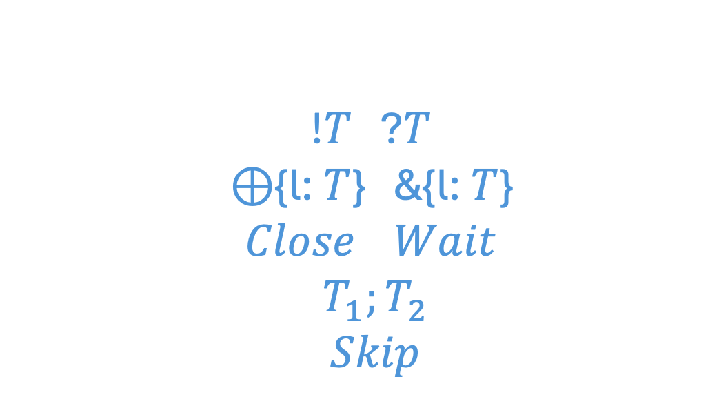
Context-free Session Types
!$T$ ?$T$ ⊕{l: $T$} &{l: $T$} $Close$ $Wait$ $T_{1};T_{2}$ $Skip$
send/receive internal/external choice close/wait channel sequential composition skip

Slide 4
Beyond Context-free Session Types
μα: S.&{Leaf: Skip, Node: α ; ?Int ; α} ; Wait
λβ: T.μα: S.&{Leaf: Skip, Node: α ; ?β ; α} ; Wait

Slide 5

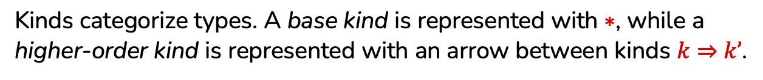
Kind
Kinds categorize types. A base kind is represented with $∗$, while a higher-order kind is represented with an arrow between kinds $k⇒k’$.
Proper Type
A proper type has a base kind.
Type Operator
A type operator acts upon types to create more complex types.
Notes:
; aplicado a T1, aplicado a T2

Slide 6
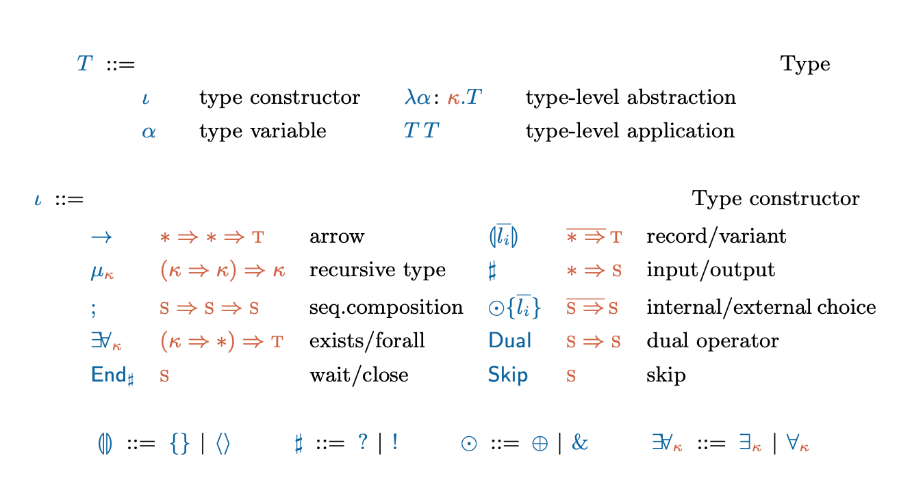

System $F_{ω}^{μ_{∗};}$

Slide 7
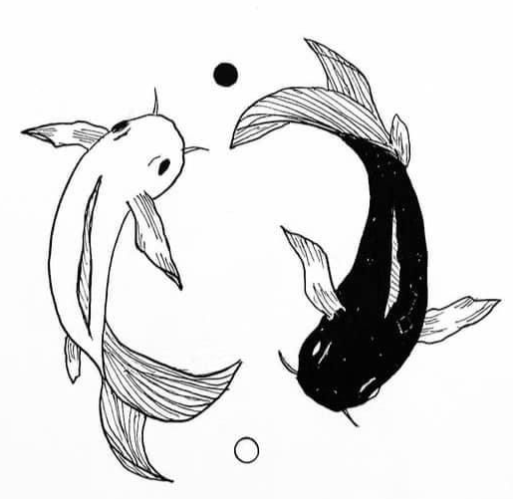
Duality
Notes:
Dual internalised.

Slide 8
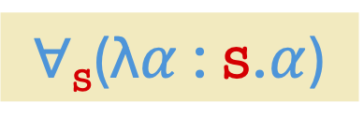
Dual ?
!Int
$∀$_{s}(λ$α$ : s.$α$)

Slide 9
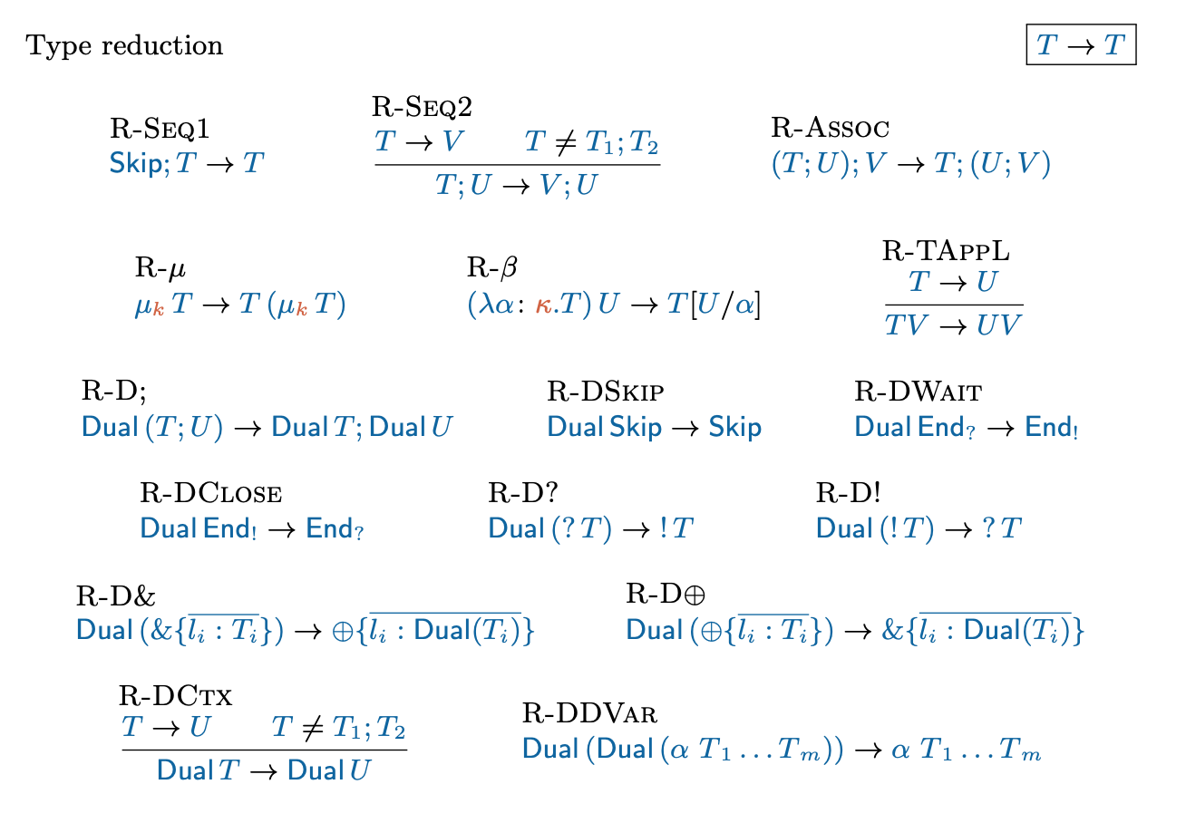
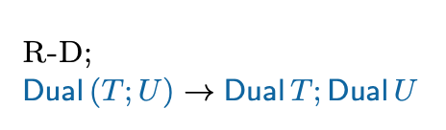
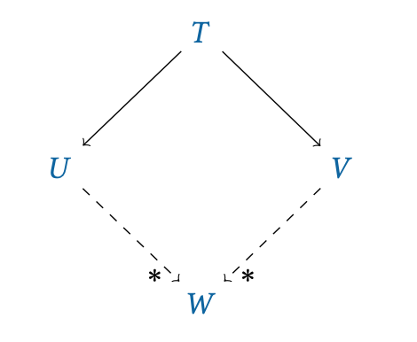
Reduction Rules
Confluence
If there are two distinct reductions for a given type, $T →U$ and $T →V$,
then both paths will eventually converge into the final reduced type $W$.
Notes:
R-D; juntar

Slide 10
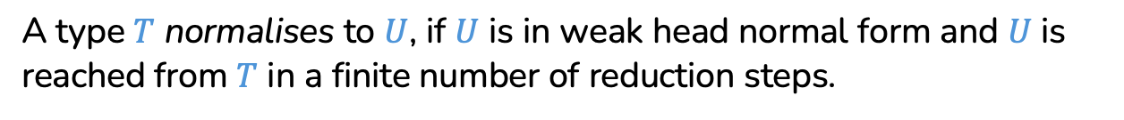
Weak Head Normal Form
A type is in weak head normal form if no reduction rule can be applied.
Normalisation
A type $T$ normalises to $U$, if $U$ is in weak head normal form and $U$ is reached from $T$ in a finite number of reduction steps.

Slide 11
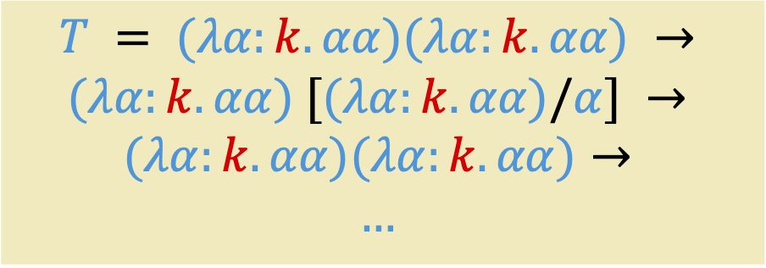

$T$ does not normalise
$$T = (λα:k. αα)(λα:k.αα) →$$
$$(λα:k.αα) [(λα:k.αα)/α] →$$
$$(λα:k.αα)(λα:k.αα)→$$
$$…$$
Loop of reductions to itself

Slide 12


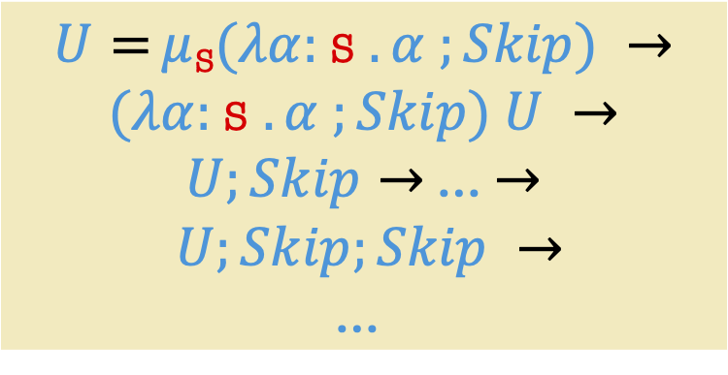
$U$ does not normalise
$U =μ$_{S}$(λα:$S $.α ;Skip) →$
$(λα:$S $.α ;Skip) U →$
$U;Skip→$ … $→$
$$U;Skip;Skip →$$
$$\text{…}$$
Trailing $Skip$.

Slide 13
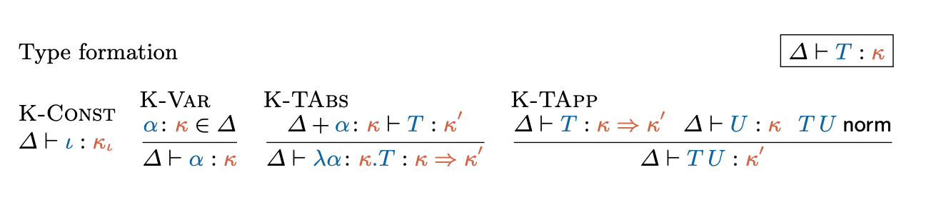
Type Formation

Slide 14
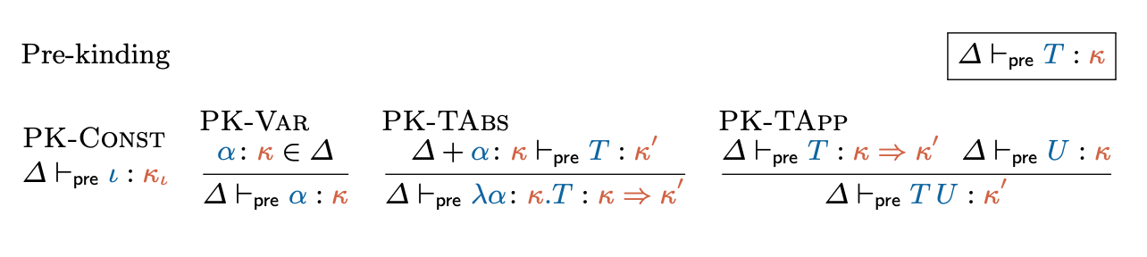
Decidability of Type Formation
Notes:
If T is pre-kinded, T norm terminates.

Slide 15



Check if $T$ is well-formed
First step
Determine if $T$ is pre-kinded, $⊢_{pre}T :κ$.
Second step
Determine if $T$ is well-formed, $⊢T :κ$ , which involves checking if $T$ and all its application subtypes normalise.
Notes:
If T is pre-kinded, T norm terminates.

Slide 16
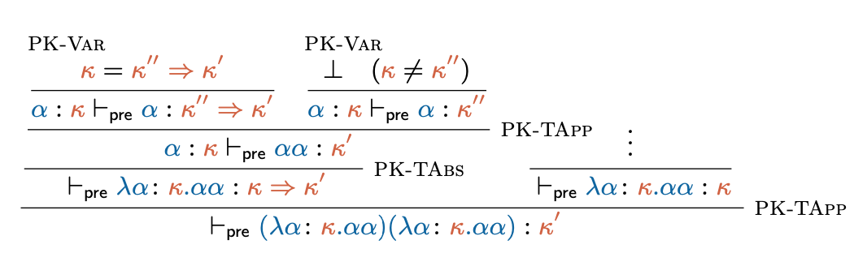

Slide 17
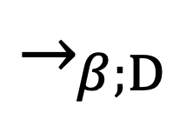
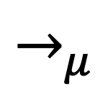
$→_{μ}$
$$→_{β;D}$$
$$T=T_{0}⇓_{β;D}T_{0}^{′}→_{μ}T_{1}⇓_{β;D}T_{1}^{′}→_{μ}T_{2}⇓_{β;D}T_{2}^{′}→_{μ}…$$

Slide 18
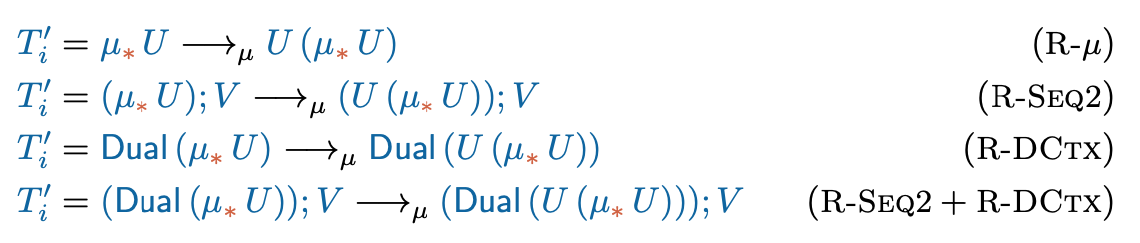

Slide 19
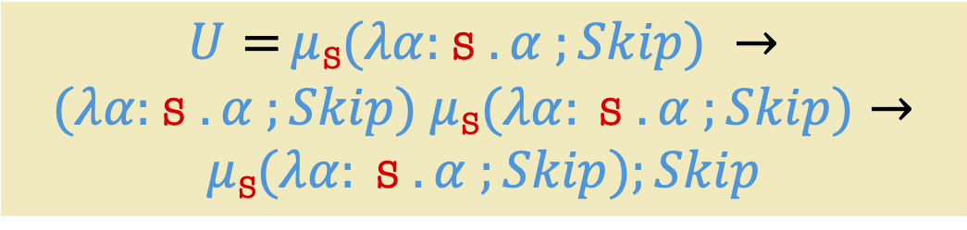
$U$ does not normalise
$U =μ$_{S}$(λα:$S $.α ;Skip) →$
$(λα:$S $.α ;Skip) μ \text{S}(λα: \text{S} .α ;Skip)→$
$$μ \text{S}(λα: \text{S} .α ;Skip);Skip$$

Slide 20
Type equivalence
Type equivalence allows checking whether two types correspond to the same protocol. Two types are equivalent if their corresponding grammars are bisimilar.

Slide 21
Type equivalence
Type equivalence allows checking whether two types correspond to the same protocol. Two types are equivalent if their corresponding grammars are bisimilar.
Minimal Renaming
Minimal renaming consists on renaming bound variables in a type by the smallest possible variable available.

Slide 22
Grammar in Greibach Normal Form
A grammar in GNF is a tuple (T , N , γ, R):
- T is a finite set of terminal symbols;
- N is a finite set of non-terminal symbols;
- γ is the starting word;
- R is a finite set of production rules.

Slide 23


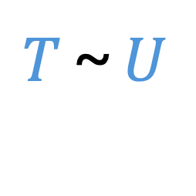
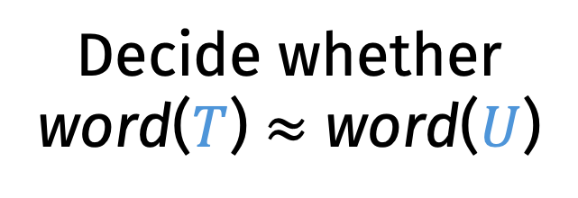
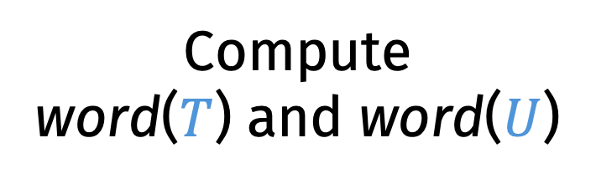
Decidability of Type Equivalence
$T$ ~ $U$
Compute word($T$) and word($U$)
Decide whether
word($T$) $≈$ word($U$)

Slide 24
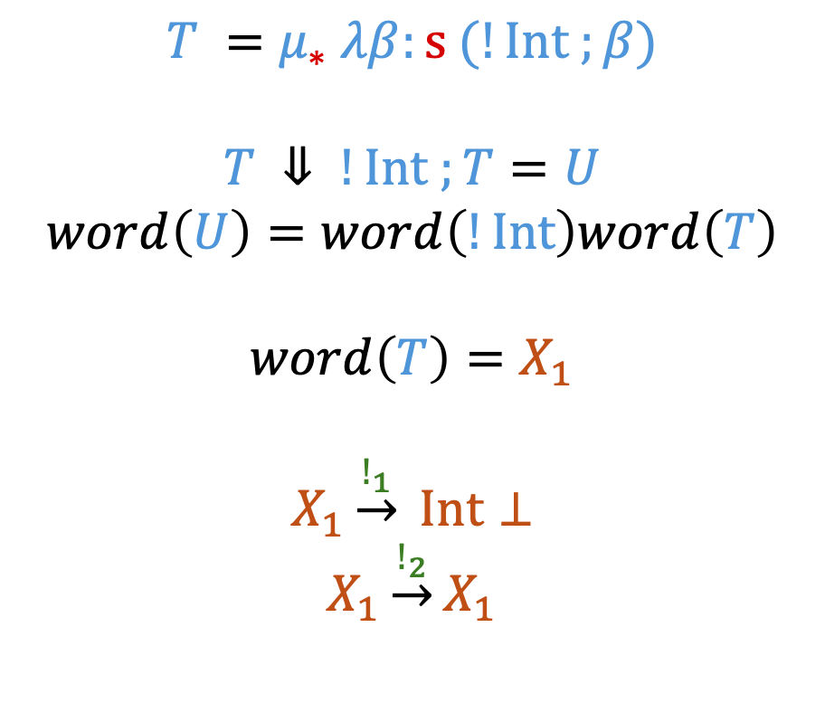
Grammar Translation
$$T =μ_{∗} λβ:s (!Int ;β)$$
$$T ⇓ !Int ;T=U$$
$$word\left(U\right)=word\left(!Int\right)word\left(T\right)$$
$$word\left(T\right)=X_{1}$$
$$X_{1}\underset{→}{!_{1}} Int⊥$$
$$X_{1}\underset{→}{!_{2}}X_{1}$$
Notes:
The application of the word function to T terminates producing a simple grammar (because our well-formed types normalise).

Slide 25
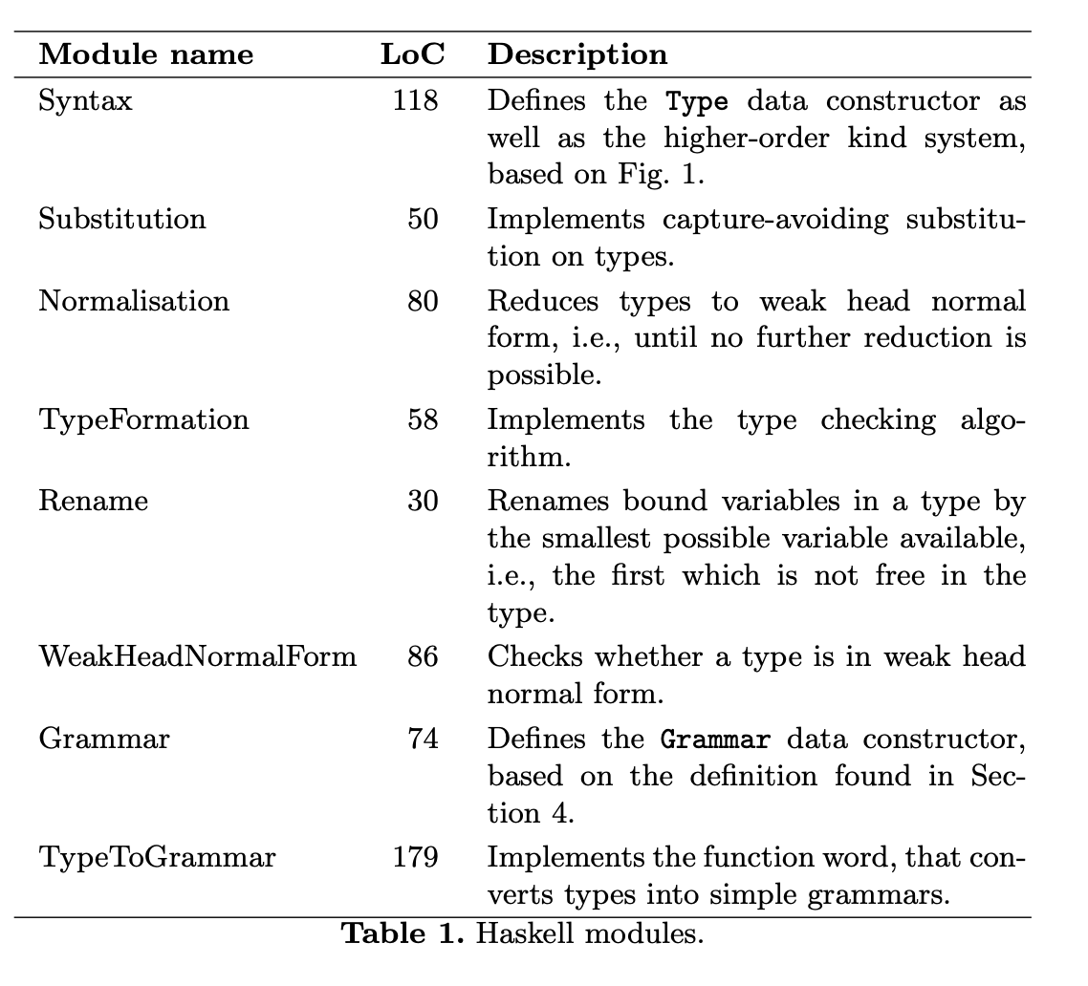
Implementation
Notes:
The application of the word function to T terminates producing a simple grammar (because our well-formed types normalise).

Slide 26
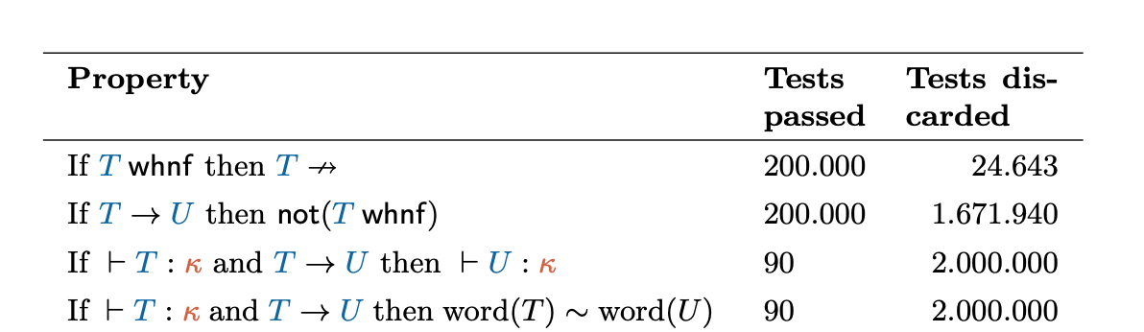
Validation
Notes:
Mention that formal proofs are present in Poças work?

Slide 27

Thank you!
Do you have any questions?
Notes:
QR code freest

